Slide 1
Inheritance and Polymorphism
Chris Kiekintveld
CS 2401 (Fall 2010)
Elementary Data Structures and Algorithms

Slide 2
Review: Classes
User-defined data types
  Defined using the “class” keyword
  Each class has associated
    Data members (any object type)
    Methods that operate on the data
New instances of the class are declared using the “new” keyword
“Static” members/methods have only one copy, regardless of how many instances are created
Java Programming: Program Design Including Data Structures

Slide 3
Example: Shared Functionality
public class Student {
String name;
char gender;
Date birthday;
Vector<Grade> grades;
double getGPA() {
…
}
int getAge(Date today) {
…
}
}
public class Professor {
String name;
char gender;
Date birthday;
Vector<Paper> papers;
int getCiteCount() {
…
}
int getAge(Date today) {
…
}
}
Java Programming: Program Design Including Data Structures

Slide 4
public class Person {
String name;
char gender;
Date birthday;
int getAge(Date today) {
…
}
}
public class Student extends Person {
Vector<Grade> grades;
double getGPA() {
…
}
}
public class Professor extends Person {
Vector<Paper> papers;
int getCiteCount() {
…
}
}
Java Programming: Program Design Including Data Structures

Slide 5
Inheritance
“is-a” relationship
Single inheritance:
  Subclass is derived from one existing class (superclass)
Multiple inheritance:
  Subclass is derived from more than one superclass
  Not supported by Java
  A class can only extend the definition of one class
Java Programming: Program Design Including Data Structures

Slide 6
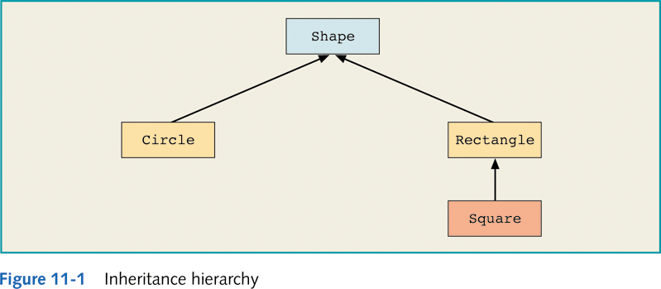
Inheritance (continued)
modifier(s) class ClassName extends ExistingClassName
modifier(s)
{
memberList
}
Java Programming: Program Design Including Data Structures

Slide 7
Inheritance: class Circle Derived from class Shape
public class Circle extends Shape
{
.
.
.
}
Java Programming: Program Design Including Data Structures

Slide 8
Inheritance
Allow us to specify relationships between types
  Abstraction, generalization, specification
  The “is-a” relationship
  Examples?
Why is this useful in programming?
  Allows for code reuse
  More intuitive/expressive code

Slide 9
Code Reuse
General functionality can be written once and applied to *any* subclass
Subclasses can specialize by adding members and methods, or overriding functions

Slide 10
Inheritance: Adding Functionality
Subclasses have all of the data members and methods of the superclass
Subclasses can add to the superclass
  Additional data members
  Additional methods
Subclasses are more specific and have more functionality
Superclasses capture generic functionality common across many types of objects
Java Programming: Program Design Including Data Structures

Slide 11
public class Person {
String name;
char gender;
Date birthday;
int getAge(Date today) {
…
}
}
public class Student extends Person {
Vector<Grade> grades;
double getGPA() {
…
}
}
public class Professor extends Person {
Vector<Paper> papers;
int getCiteCount() {
…
}
}
Java Programming: Program Design Including Data Structures

Slide 12
Brainstorming
What are some other examples of possible inheritance hierarchies?
  Person -> student, faculty…
  Shape -> circle, triangle, rectangle…
  Other examples???
Java Programming: Program Design Including Data Structures

Slide 13
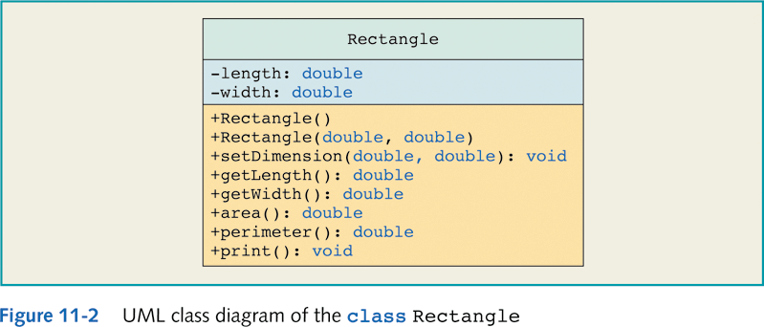
UML Diagram: Rectangle
What if we want to implement a 3d box object?
Java Programming: Program Design Including Data Structures

Slide 14
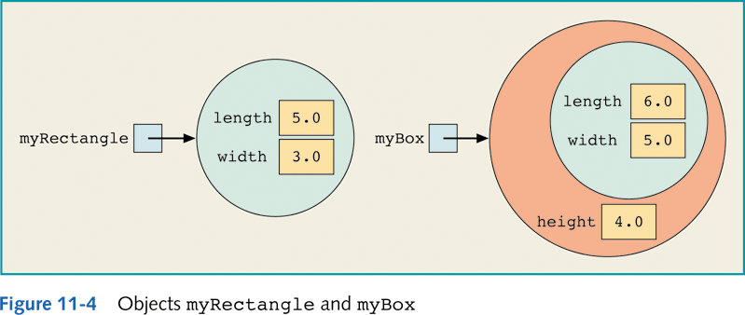
Objects myRectangle and myBox
Rectangle myRectangle = new Rectangle(5, 3);
Box myBox = new Box(6, 5, 4);
Java Programming: Program Design Including Data Structures

Slide 15
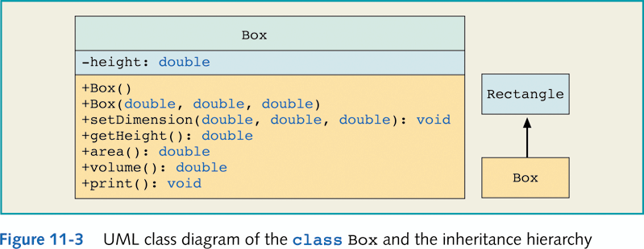
UML Class Diagram: class Box
Both a Rectangle and a Box have a surface area,
but they are computed differently
Java Programming: Program Design Including Data Structures

Slide 16
Overriding Methods
A subclass can override (redefine) the methods of the superclass
  Objects of the subclass type will use the new method
  Objects of the superclass type will use the original
Java Programming: Program Design Including Data Structures

Slide 17
class Rectangle
public double area()
{
return getLength() * getWidth();
}
class Box
public double area()
{
return 2 * (getLength() * getWidth()
+ getLength() * height
+ getWidth() * height);
}
Java Programming: Program Design Including Data Structures

Slide 18
final Methods
Can declare a method of a class final using the keyword final
public final void doSomeThing()
{
//...
}
If a method of a class is declared final, it cannot be overridden with a new definition in a derived class
Java Programming: Program Design Including Data Structures

Slide 19
Calling methods of the superclass
To write a method’s definition of a subclass, specify a call to the public method of the superclass
  If subclass overrides public method of superclass, specify call to public method of superclass:
  super.MethodName(parameter list)
  If subclass does not override public method of superclass, specify call to public method of superclass:
  MethodName(parameter list)
Java Programming: Program Design Including Data Structures

Slide 20
class Box
public void setDimension(double l, double w, double h)
{
super.setDimension(l, w);
if (h >= 0)
height = h;
else
height = 0;
}}
Box overloads the method setDimension
(Different parameters)
Java Programming: Program Design Including Data Structures

Slide 21
Defining Constructors of the Subclass
Call to constructor of superclass:
  Must be first statement
  Specified by super parameter list
public Box()
{
super();
height = 0;
}
public Box(double l, double w, double h)
{
super(l, w);
height = h;
}
Java Programming: Program Design Including Data Structures

Slide 22
Access Control
Access control keywords define which classes can access classes, methods, and members
Modifier | Class | Package | Subclass | World
public | Y | Y | Y | Y
protected | Y | Y | Y | N
none | Y | Y | N | N
private | Y | N | N | N
Java Programming: Program Design Including Data Structures

Slide 23
Polymorphism
Can treat an object of a subclass as an object of its superclass
  A reference variable of a superclass type can point to an object of its subclass
  Person name, nameRef;
  PartTimeEmployee employee, employeeRef;
  name = new Person("John", "Blair");
  employee = new PartTimeEmployee("Susan", "Johnson",
  12.50, 45);
  nameRef = employee;
  System.out.println("nameRef: " + nameRef);
  nameRef: Susan Johnson wages are: $562.5
Java Programming: Program Design Including Data Structures

Slide 24
Polymorphism
Late binding or dynamic binding (run-time binding):
  Method to be executed is determined at execution time, not compile time
Polymorphism: to assign multiple meanings to the same method name
Implemented using late binding
Java Programming: Program Design Including Data Structures

Slide 25
Polymorphism (continued)
The reference variable name or nameRef can point to any object of the class Person or the class PartTimeEmployee
These reference variables have many forms, that is, they are polymorphic reference variables
They can refer to objects of their own class or to objects of the classes inherited from their class
Java Programming: Program Design Including Data Structures

Slide 26
Polymorphism and References
Shape myShape = new Circle(); // allowed
Shape myShape2 = new Rectangle(); // allowed
Rectangle myRectangle = new Shame(); // NOT allowed
Java Programming: Program Design Including Data Structures

Slide 27
Polymorphism (continued)
Can also declare a class final using the keyword final
If a class is declared final, then no other class can be derived from this class
Java does not use late binding for methods that are private, marked final, or static
  Why not?
Java Programming: Program Design Including Data Structures

Slide 28
Casting
You cannot automatically make reference variable of subclass type point to object of its superclass
Suppose that supRef is a reference variable of a superclass type and supRef points to an object of its subclass:
  Can use a cast operator on supRef and make a reference variable of the subclass point to the object
  If supRef does not point to a subclass object and you use a cast operator on supRef to make a reference variable of the subclass point to the object, then Java will throw a ClassCastException—indicating that the class cast is not allowed
Java Programming: Program Design Including Data Structures

Slide 29
Polymorphism (continued)
Operator instanceof: determines whether a reference variable that points to an object is of a particular class type
This expression evaluates to true if p points to an object of the class BoxShape; otherwise it evaluates to false:
p instanceof BoxShape
Java Programming: Program Design Including Data Structures

Slide 30
Abstract Methods
A method that has only the heading with no body
Must be implemented in a subclass
Must be declared abstract
  public double abstract area();
  public void abstract print();
  public abstract object larger(object,
  object);
  void abstract insert(int insertItem);
Java Programming: Program Design Including Data Structures

Slide 31
Abstract Classes
A class that is declared with the reserved word abstract in its heading
An abstract class can contain instance variables, constructors, finalizers, and non-abstract methods
An abstract class can contain abstract methods
Java Programming: Program Design Including Data Structures

Slide 32
Abstract Classes (continued)
If a class contains an abstract method, the class must be declared abstract
You cannot instantiate an object of an abstract class type; can only declare a reference variable of an abstract class type
You can instantiate an object of a subclass of an abstract class, but only if the subclass gives the definitions of all the abstract methods of the superclass
Java Programming: Program Design Including Data Structures

Slide 33
Abstract Class Example
public abstract class AbstractClassExample
{
protected int x;
public void abstract print();
public void setX(int a)
{
x = a;
}
public AbstractClassExample()
{
x = 0;
}
}
Java Programming: Program Design Including Data Structures

Slide 34
Interfaces
A class that contains only abstract methods and/or named constants
How Java implements multiple inheritance
To be able to handle a variety of events, Java allows a class to implement more than one interface
Java Programming: Program Design Including Data Structures

Slide 35
Composition
Another way to relate two classes
One or more members of a class are objects of another class type
“has-a” relation between classes
  For example, “every person has a date of birth”
Java Programming: Program Design Including Data Structures

Slide 36
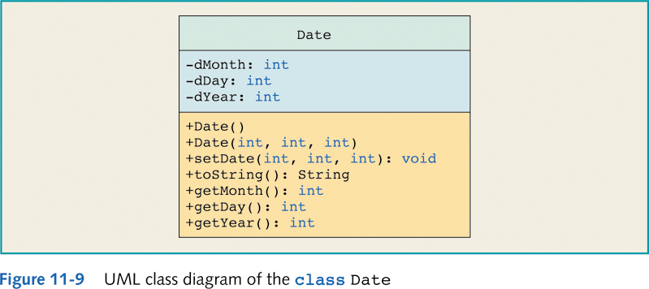
Composition Example
Java Programming: Program Design Including Data Structures

Slide 37
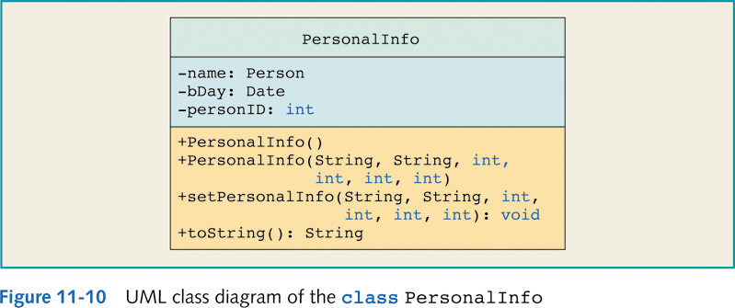
Composition Example (continued)
Java Programming: Program Design Including Data Structures

